Slide 1
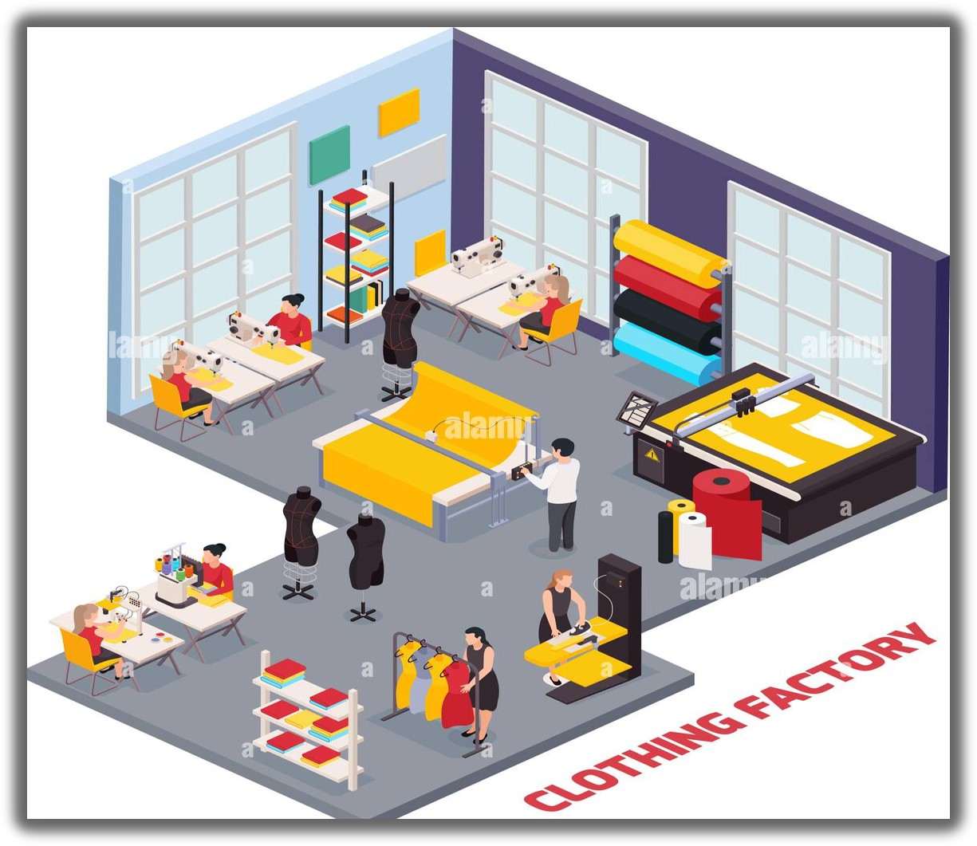
Manufacturing Project

Slide 2

Our Teammates
Vishal Kumar
Ishita Solanki
Vaishnavi Kongale
Ashwin Patidar
Palve Jayshree Ramnath
Dandagala Saikumar

Slide 3
Introduction
Overview Of The Garment Manufacturing Industry:
The Garment Manufacturing Industry Produces Clothing And Accessories Through Various Stages, Including Design, Fabric Sourcing, Cutting, Sewing, And Finishing. It Operates Globally And Caters To Diverse Consumer Preferences.
Purpose Of The Project:
This Project Aims To Innovate And Improve Garment Manufacturing Processes To Enhance Efficiency, Sustainability, And Competitiveness Within The Industry.
Goals And Objectives:
Enhance Efficiency And Reduce Lead Times.
Integrate Sustainable Practices Throughout The Supply Chain.
Adopt Innovative Technologies To Modernize Operations.
Improve Product Quality And Consistency.
Strengthen Market Competitiveness.
Prioritize Worker Welfare And Safety.
Ensure Customer Satisfaction.
Drive Sustainable Growth And Profitability.

Slide 4
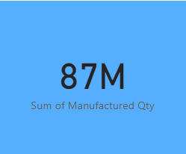
PERFORMANCE METRICS
KPI 1 : Manufacture Qty
The total quantity of items produced within A specific time frame.
IMPORTANCE:
Indicates the volume of output from the manufacturing process.
Visualization:
Chart showing production quantity over time.
Insight:
Tracking the manufacture quantity over time can reveal production trends, such as seasonality or periods of high demand.
Actionable Insight:
Identify peak production periods to optimize resource allocation and scheduling.

Slide 5
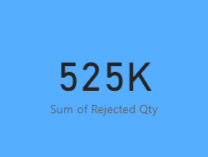
KPI 2 : Rejected Qty
DEFINITION:
The quantity of items rejected during the manufacturing process due to defects or quality issues.
Importance:
Reflects the effectiveness of quality control measures.
VISUALIZATION:
Showing rejected quantity to total production.
Insight:
Monitoring rejected quantity helps identify quality issues in the manufacturing process.
actionable Insight:
Investigate root causes of rejected items to implement corrective actions and improve quality control procedures.

Slide 6
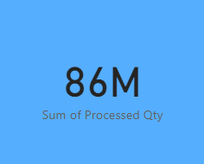
KPI 3 : Processed Qty
Definition:
The quantity of items successfully completed through the manufacturing process.
Importance:
Indicates the portion of production meeting quality standards.
Visualization:
Chart illustrating the total processed quantity.
Insight:
Comparing processed quantity to total production indicates the efficiency of the manufacturing process.
Actionable Insight:
Streamline production processes and reduce cycle times to increase the proportion of processed quantity.

Slide 7
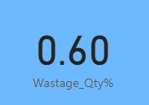
KPI 4 : Wastage Qty
Definition:
The quantity of materials wasted during the manufacturing process.
Importance:
Highlights inefficiencies in material usage and production processes.
Visualization:
Showing the breakdown of waste by material type.
Insight:
Analyzing wastage quantity highlights inefficiencies in material usage and production processes.
Actionable Insight:
Implement waste reduction strategies such as lean manufacturing principles or recycling initiatives to minimize wastage.

Slide 8
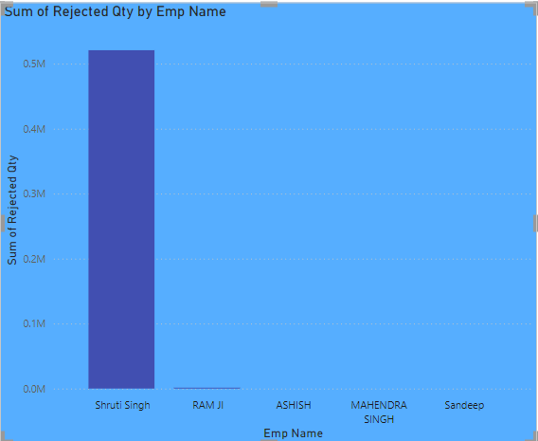
KPI 5 : Employee Wise Rejected Qty
Definition:
The quantity of rejected items attributed to individual employees.
Importance:
Identifies training needs or performance issues among employees.
Visualization:
Stacked Column chart ranking employees by rejected quantity.
Insight:
Identifying employees with high rejected quantities can indicate training needs or performance issues.
Actionable Insight:
Provide targeted training and performance feedback to improve employee skills and reduce rejected quantity.

Slide 9
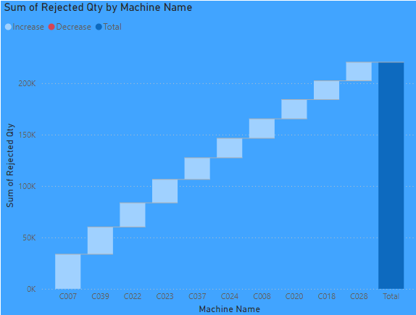
KPI 6 : Machine Wise Rejected Qty
Definition:
The quantity of rejected items attributed to specific machines.
Importance:
Helps optimize machine utilization and maintenance schedules.
Visualization:
Waterfall showing the machines with the highest rejected quantity.
Insight:
Machines with high rejected quantities may indicate maintenance issues or inefficiencies in operation.
Actionable Insight:
Schedule preventive maintenance and optimize machine utilization to reduce rejected quantity and downtime.

Slide 10
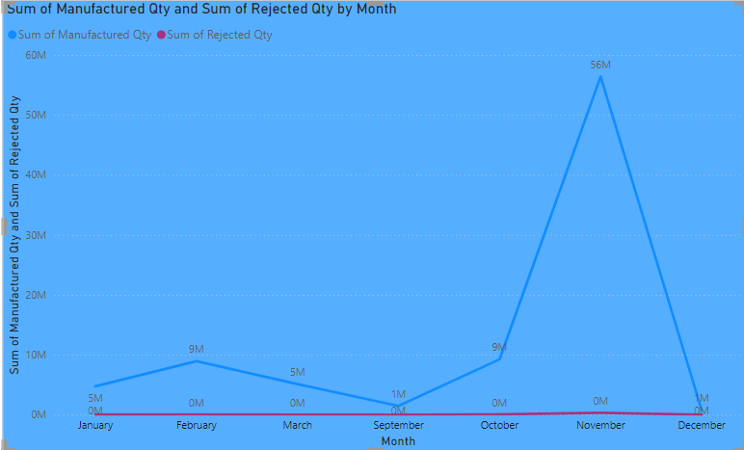
KPI 7 : Production Comparison trend
Definition:
Analysis of production quantities over time to identify trends and patterns.
Importance:
Provides insights into production fluctuations and seasonality.
Visualization:
Line graph showing production trend over multiple time periods.
Insight:
Analyzing production trends over time reveals patterns and seasonality in demand.
Actionable Insight:
Adjust production schedules and inventory levels to meet fluctuating demand more effectively.

Slide 11
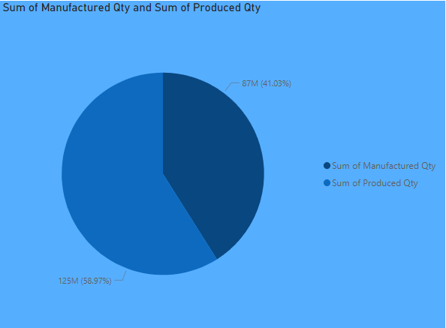
KPI 8 : Manufacture Vs Rejected
Definition:
A comparison between total manufactured quantity and total quantity rejected.
Importance:
Evaluates the efficiency and quality of the manufacturing process.
Visualization:
Pie chart comparing the percentages between manufactured and rejected quantities.
Insight:
Comparing manufactured quantity to rejected quantity provides insights into the effectiveness of quality control measures.
Actionable Insight:
Set quality targets and implement continuous improvement initiatives to reduce the proportion of rejected quantity.

Slide 12
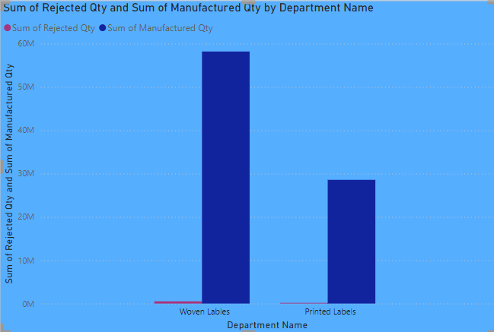
KPI 9 : Department Wise Manufacture Vs Rejected
Definition:
Breakdown of manufactured and rejected quantities by department.
Importance:
Identifies areas for improvement and allocation of resources.
Visualization:
Clustered column chart comparing manufactured and rejected quantities by department.
Insight:
Variations in manufacture and rejected quantities among departments indicate areas for improvement.
Actionable Insight:
Allocate resources and prioritize quality improvement efforts based on departmental performance.

Slide 13
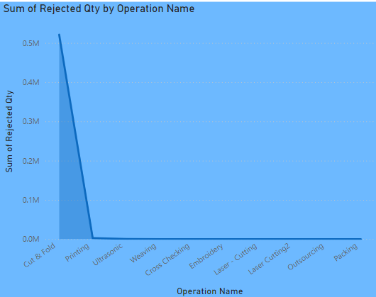
KPI 10 : Operation Wise Rejected Qty
Definition:
Quantity of rejected items attributed to specific operations.
Importance:
Identifies areas of improvement within the manufacturing process.
Visualization:
Stacked area chart showing the rejected quantity attributed to each operation.
Insight:
Quantity of rejected items attributed to specific operations helps identify bottlenecks and inefficiencies in the manufacturing process.
Actionable Insight:
Analyze and optimize operations with high rejection quantities to improve overall process efficiency and product quality.

Slide 14
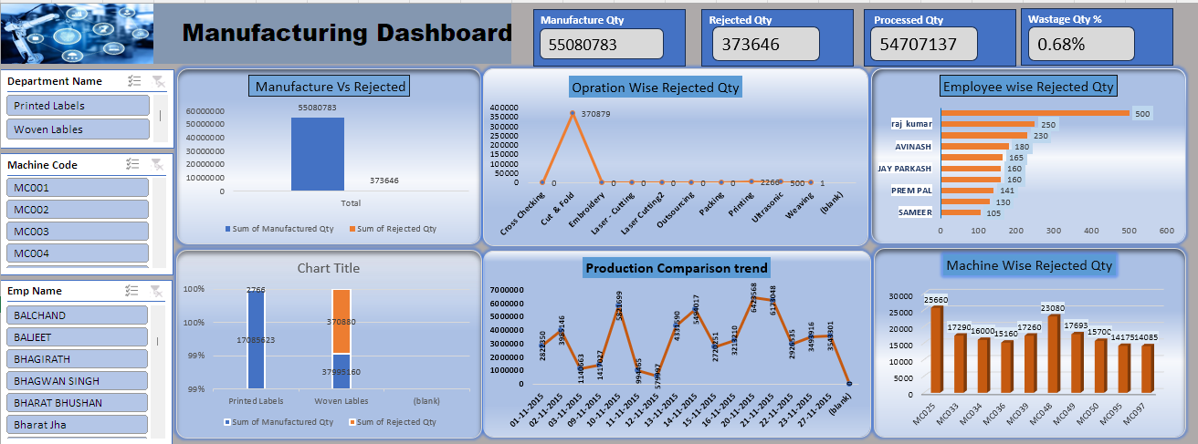
EXCEL dashboard

Slide 15
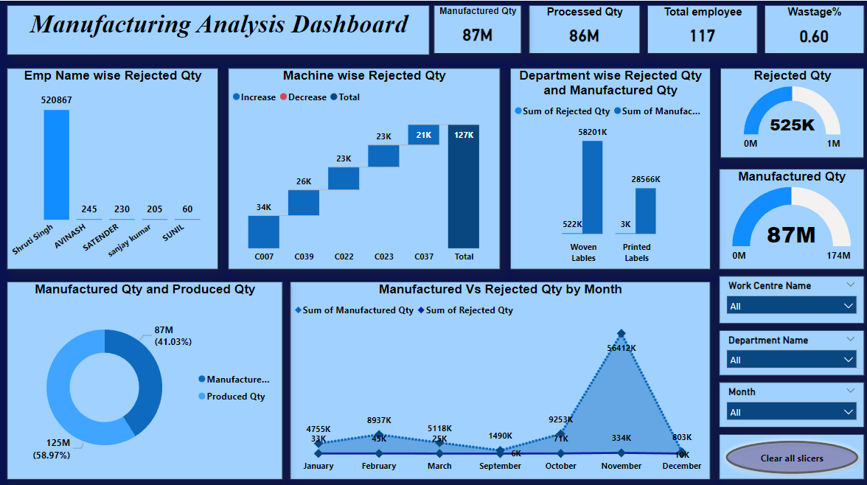
POWER BI dashboard

Slide 16
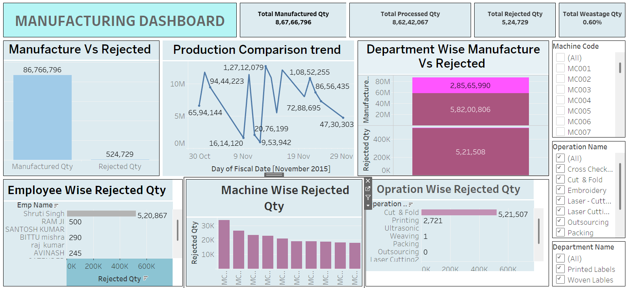
TABLEAU dashboard

Slide 17
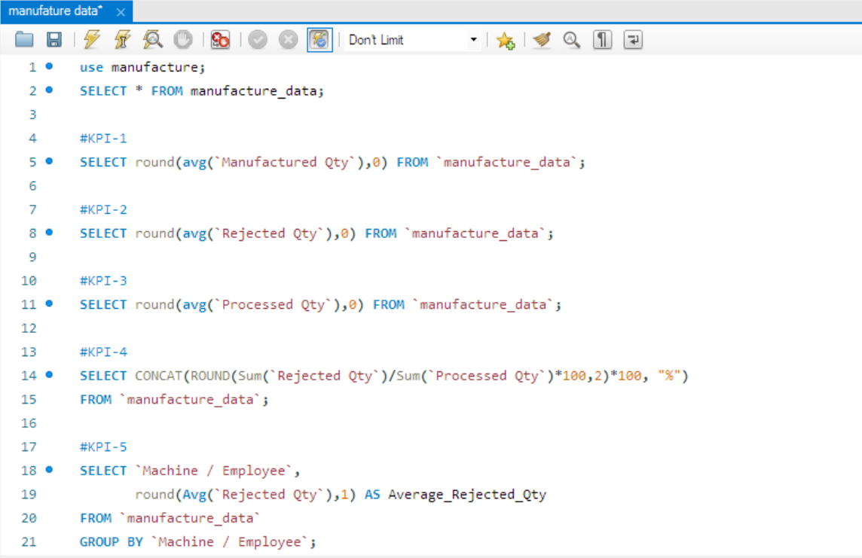
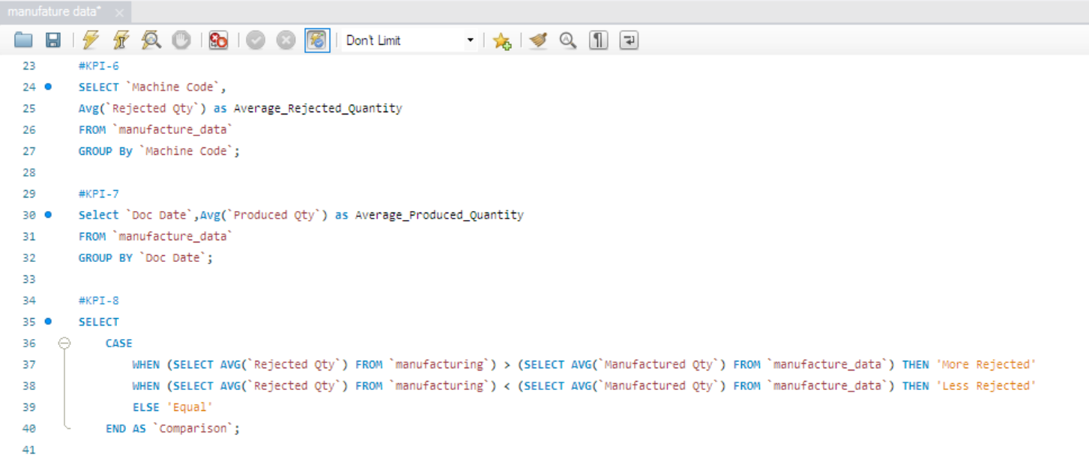
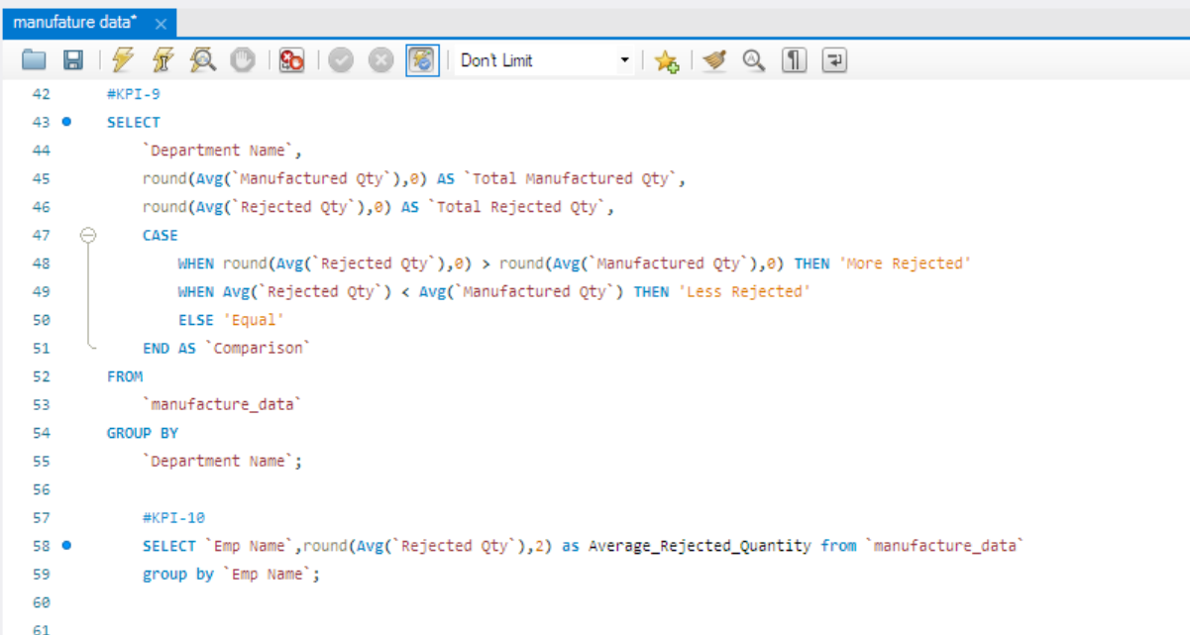
SQL queries

Slide 18
Recommendations
Inconsistent & Incomplete Data
Set strict data entry guidelines and validation rules across all departments to ensure clean, uniform inputs.
Root Cause Identification Require employees and supervisors to record detailed reasons for every rejection immediately at the point of process failure.
Interpreting Trends & Outliers Schedule weekly review meetings to interpret anomalies early instead of waiting for monthly summaries.
Resource Constraints Focus first on major bottlenecks and high-rejection departments to maximize improvement with limited resources.

Slide 19
Data Modelling
Throughout our analysis, we encountered various challenges in handling the data:
Inconsistent & incomplete data
Difficulty collecting accurate production and rejection data across departments.
Time-consuming data cleaning
Significant effort required to clean and structure raw datasets for analysis.
Tool integration issues
Coordinating outputs between excel, power BI, tableau, and SQL posed challenges.
Root cause identification
Pinpointing reasons for rejection at employee or machine level required deep investigation.
Complex KPI tracking
Managing and visualizing 10+ kpis across departments and processes was technically demanding.
Interpreting trends & outliers
Analyzing production fluctuations and identifying patterns in rejection data took multiple iterations.
Resource constraints
Limited time and team bandwidth impacted the depth of analysis and dashboard refinement.

Slide 20
Conclusion
🔹 KPI 1– 4: Wastage & Rejection overview
High rejection and wastage rates were observed in specific departments and processes.
Standardized data entry and operator-level tracking are essential to reduce defects.
Manufacture quantity (qty):
Monitoring the manufacture quantity provides insights into production volumes, enabling efficient resource allocation and scheduling to meet demand.
2. Rejected quantity (qty):
Analyzing rejected quantity helps identify areas for quality improvement, leading to reduced waste, improved product quality, and enhanced customer satisfaction.
3. Processed quantity (qty):
Tracking processed quantity indicates the efficiency of manufacturing processes and highlights areas for optimization to increase throughput and reduce cycle times.
4. Wastage quantity (qty):
Understanding wastage quantity allows for the identification of inefficiencies in material usage and production processes, facilitating waste reduction initiatives and cost savings.

Slide 21
🔹 KPI 5: Rejections by Employee
Significant variance in rejection rates across employees highlighted the need for targeted training and performance monitoring.
🔹 KPI 6: Rejections by Machine
Certain machines contributed disproportionately to rejected output, indicating a need for preventive maintenance or machine recalibration.
🔹 KPI 7: Overall Production vs Rejection
Aggregate data showed that while output was consistent, rejection rates offset productivity gains.
Root cause analysis and quality control improvements are key to boosting net output.
🔹 KPI 8: Daily Production Trend
Identified fluctuations in daily output, pointing to workflow inefficiencies or operational delays on certain days.
🔹 KPI 9: Label Type Analysis
Woven labels had higher rejection rates compared to printed ones.
Suggested focused process review and material checks.
🔹 KPI 10: Rejections by Process Type
“Cut & Fold” and “Cross Checking” stages showed higher rejection ratios.
Recommend revisiting process SOPs and operator handling for these steps.

Slide 22
Thank You….

